Slide 1
Installation of Windows XP

Slide 2
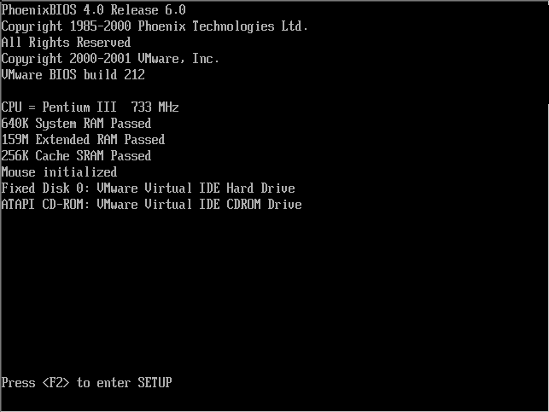
Following steps to install Windows XP:
Step 1:
Power on the computer then press the delete key. After pressing delete key, it moves into ‘BIOS’. In that BIOS we have to set group boot device priority .Give 1st priority to CD-ROM drive, 2nd priority Hard Disk and 3rd priority to Floppy disc. Then press F10 (F10 means-save & exit)

Slide 4

Insert XP CD into CD drive and looking for message booting from CD“ Press any key to boot from CD” , Then press Enter key.
Step 2:

Slide 5
Step 3:

Slide 6
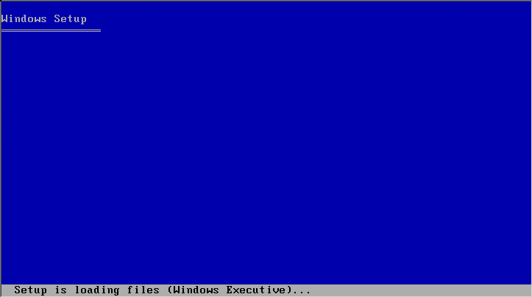
Setup will start Copying files

Slide 7
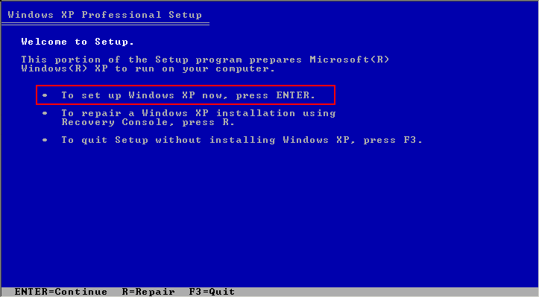
Step 4:
You will then get a Windows XP Professional Setup screen. You have the option to do a new Windows install, Repair previous install or quit. Since we are doing a new install we just press Enter to continue.

Slide 9
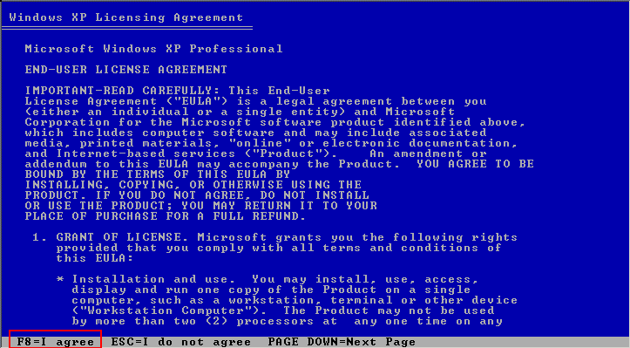
Step 5:
Windows License agreement message will be displayed then you have to read .if you agree press F8 to Continue.. if you not agree press ESC key .

Slide 11
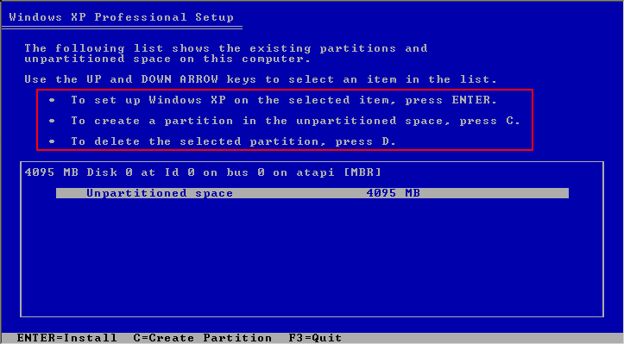
Step 6:
This step is very important. Here we will create the partition where Windows will be installed. If you have a brand new unformatted drive you will get a screen similar to below.

Slide 13
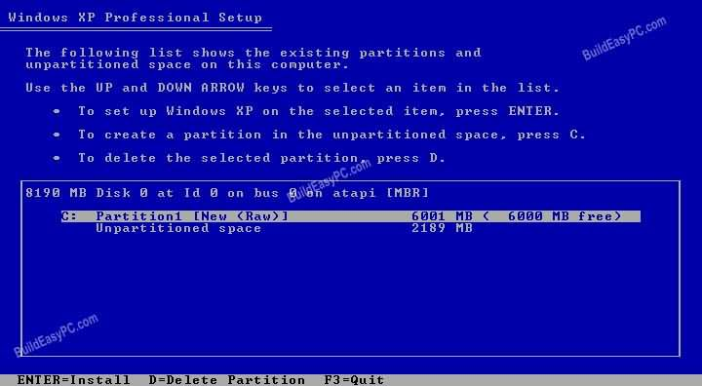
Now you use the up & down arrow keys to select the partition you want to install into, then press ‘Enter ‘ to continue. You can use the same partition as used by the previous o.s. If you want to create partition press ‘c’, to Delete partition press ‘D’ & ‘L’.
Step 7:

Slide 15
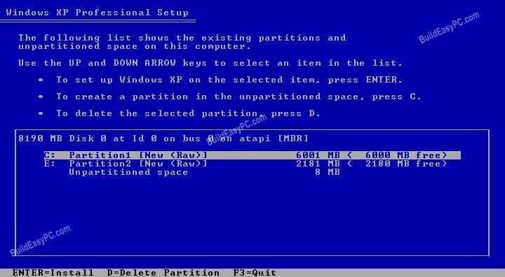
Step 8:
Now you will see both partition listed. Partition 1 (C: Drive) 6000MB and Partition 2 (E: Drive) 2180MB. You will also have 8MB of un partitioned space. Select Partition 1 (C: Drive) and press Enter.

Slide 17
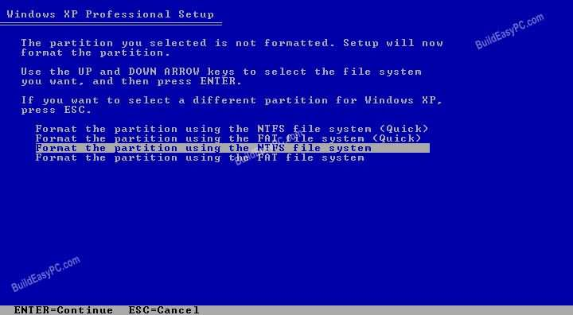
Step 9:
Choose format the partition using NTFS file system. This is the recommended file system. If the hard drive has been formatted before then you can choose quick NTFS format. We chose NTFS because it offers many security features, supports larger drive size, and bigger size files.

Slide 19
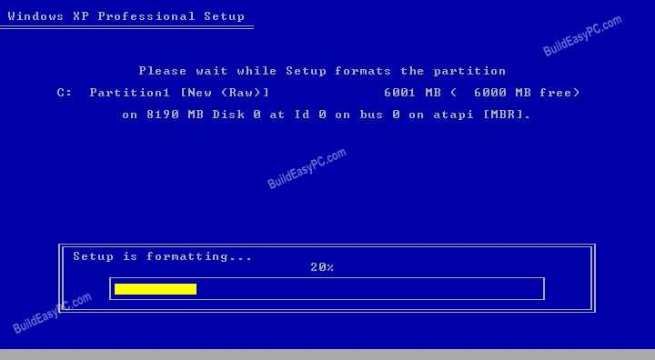
Step 10:
Windows will now start formatting drive C

Slide 21
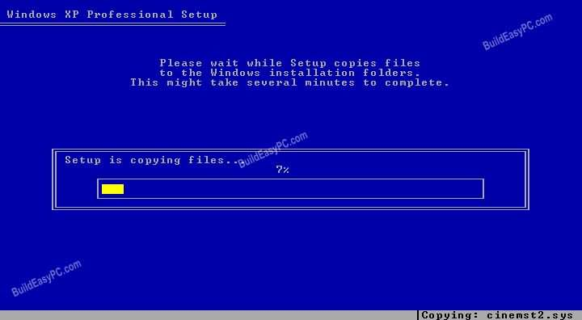
start copying setup files as shown on the image below :
Step 11:

Slide 23
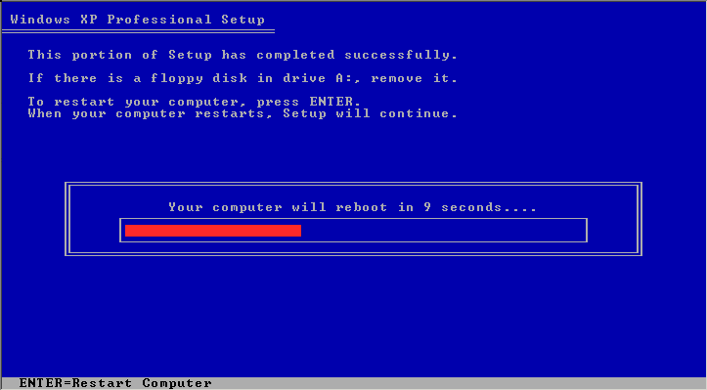
After the setup has completed copying the files the computer will restart. Remove the XP CD in the drive but this time DO NOT press any key when the message "Press any key to boot from CD" is displayed. In few seconds setup will continue
Step 12:

Slide 24
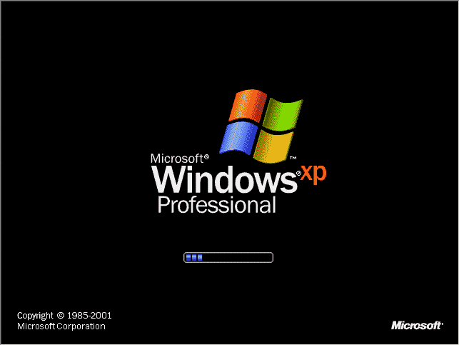

Slide 25
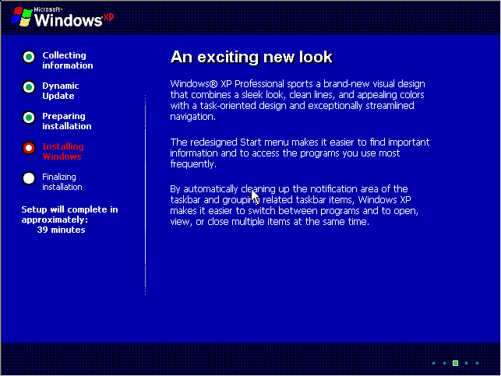
Step 13:
Windows XP Setup wizard will guide you through the setup process of gathering information about your computer.

Slide 27
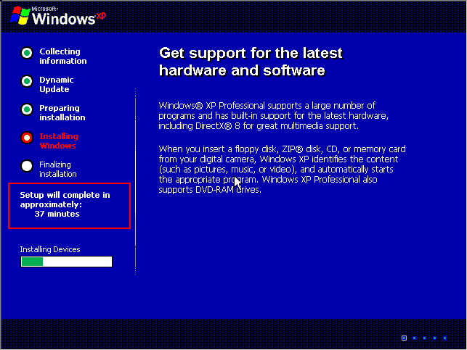

Slide 28
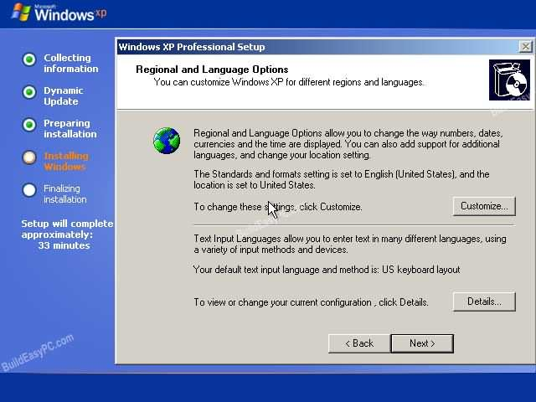
Step 14:
Choose your region and language.

Slide 30
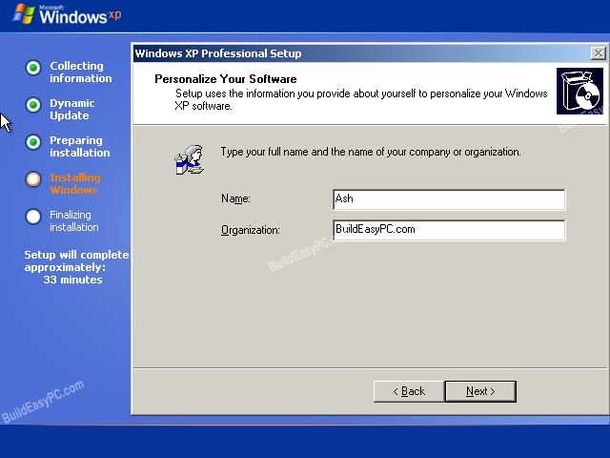
Step 15:
Type in your name and organization.

Slide 32
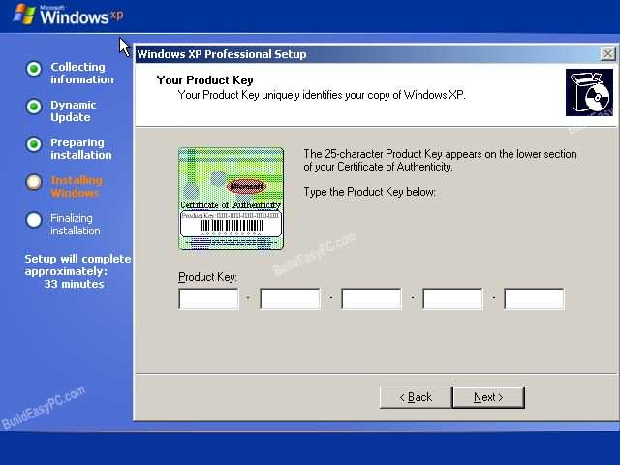
Step 16:
Enter your product key . The product key will be available on the window-XP software CD of length 25 digits, after enter this product key then press ‘Next’.

Slide 34
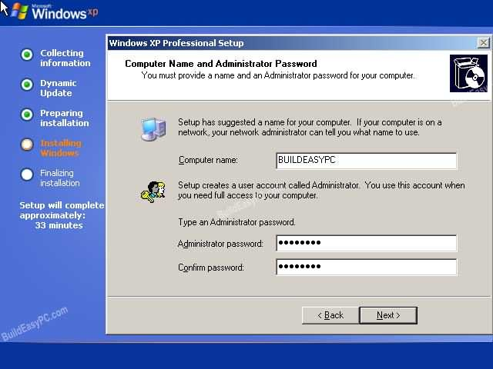
Step 17:
Name the computer, and enter an Administrator password. Don't forget to write down your Administrator password.

Slide 36
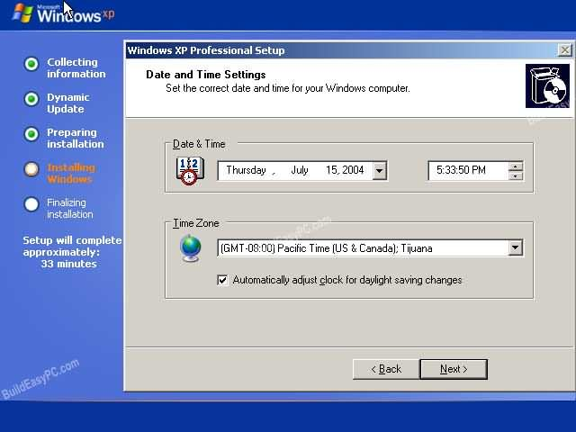
Step 18:
Enter the correct date, time and choose your time zone and then press ‘next’

Slide 38
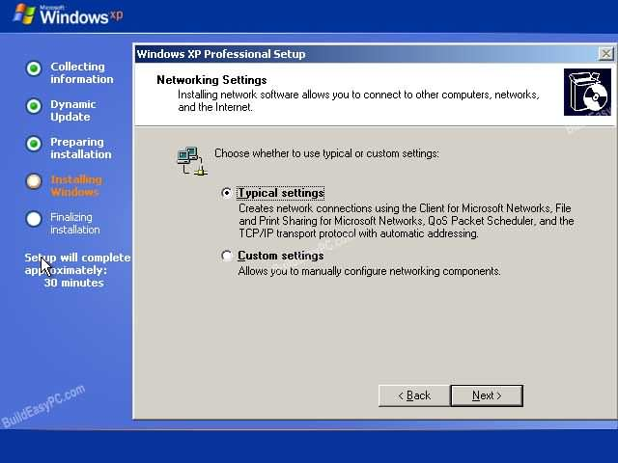
Step 19:
For the network setting choose typical and press next.

Slide 40
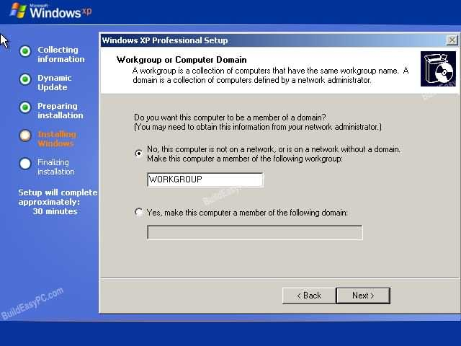
Step 20:
Choose work group or domain name. If you are not a member of a domain then leave the default settings and press next. Windows will restart again and adjust the display.

Slide 42
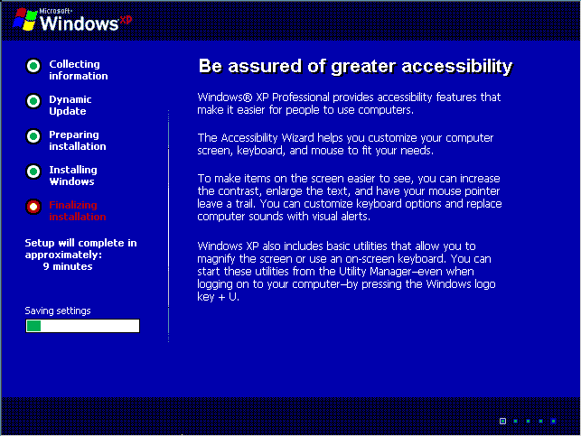

Slide 43
Step 21:
Windows installation process will be finalized Now it is time to restart the windows-XP again.

Slide 44
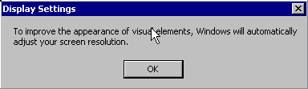
Windows will now adjust your resolution. Click ‘ok’ to continue.
Step 22:

Slide 45
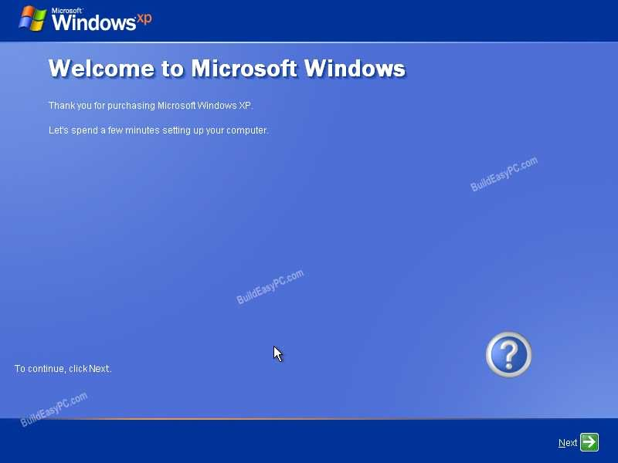
Step 23:
Finally Windows will start and Windows welcomes screen is displayed on the screen. Click next to continue.

Slide 47
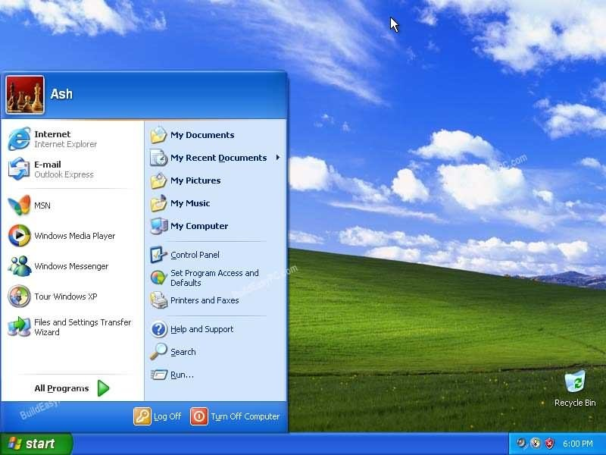
Step 24:
Log in, to your PC for the first time.

